Slide 1
Prediction on US Stock Market Performance: S&P 500
Danning (Danni) Lai, Sijia (Nancy) Li,
Xu (Victoria) Tang, and Hanlin (Lily) Zhu

Slide 2
01
Introduction

Slide 3

Motivation and Problem Statement
Problem of Interest: Predict the performance of S&P 500 index using leading indicators from energy, gold, and US Treasury markets
Traders, Fund Managers
Data-Driven Models
Leading Indicators

Slide 4
02
Data

Slide 5

Data Description and Preprocessing
01
Data Collection & Feature Engineering
Adjusted closing price:
S&P 500
Crude oil futures price
Gold futures price
Log return of x
= ln(x_{t}) / ln(x_{t+1}) x 100
Log return of S&P 500
Log return of crude oil futures price
Gold futures price
First-order differencing
13-week treasury bill yield
10-year treasury note yield
Change in 13-week T-bill yield
Change in 10Y-3M treasury yield spread

Slide 6
Data Description and Preprocessing
02
03
Missingness
Estimation-Prediction Sets Split
Forward Fill: when there is no data for a particular market on a trading day
Estimation Set: first 95%, 2002-11-10 to 2021-10-31
Prediction Set: last 5%, 2021-11-07 to 2022-10-30
95-5 split because training fixed scheme models (can’t predict well too far into the future)

Slide 7
03
Exploratory Data Analysis

Slide 8
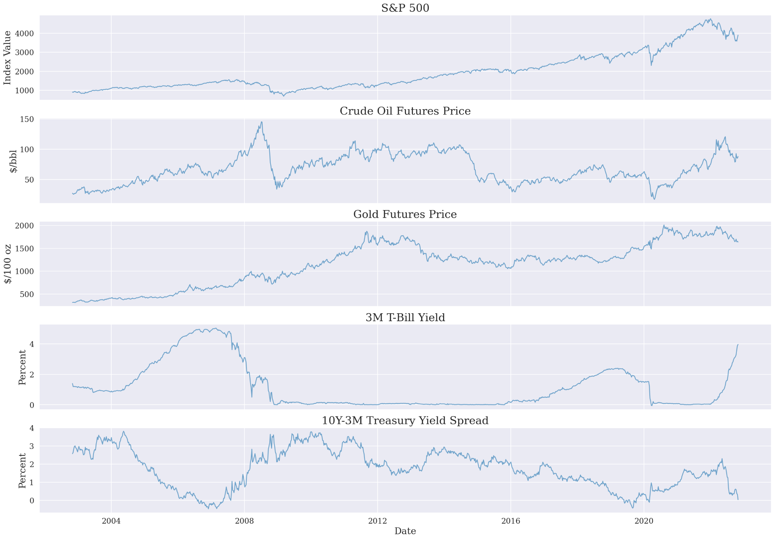
3.1 Visualization of data

Slide 9
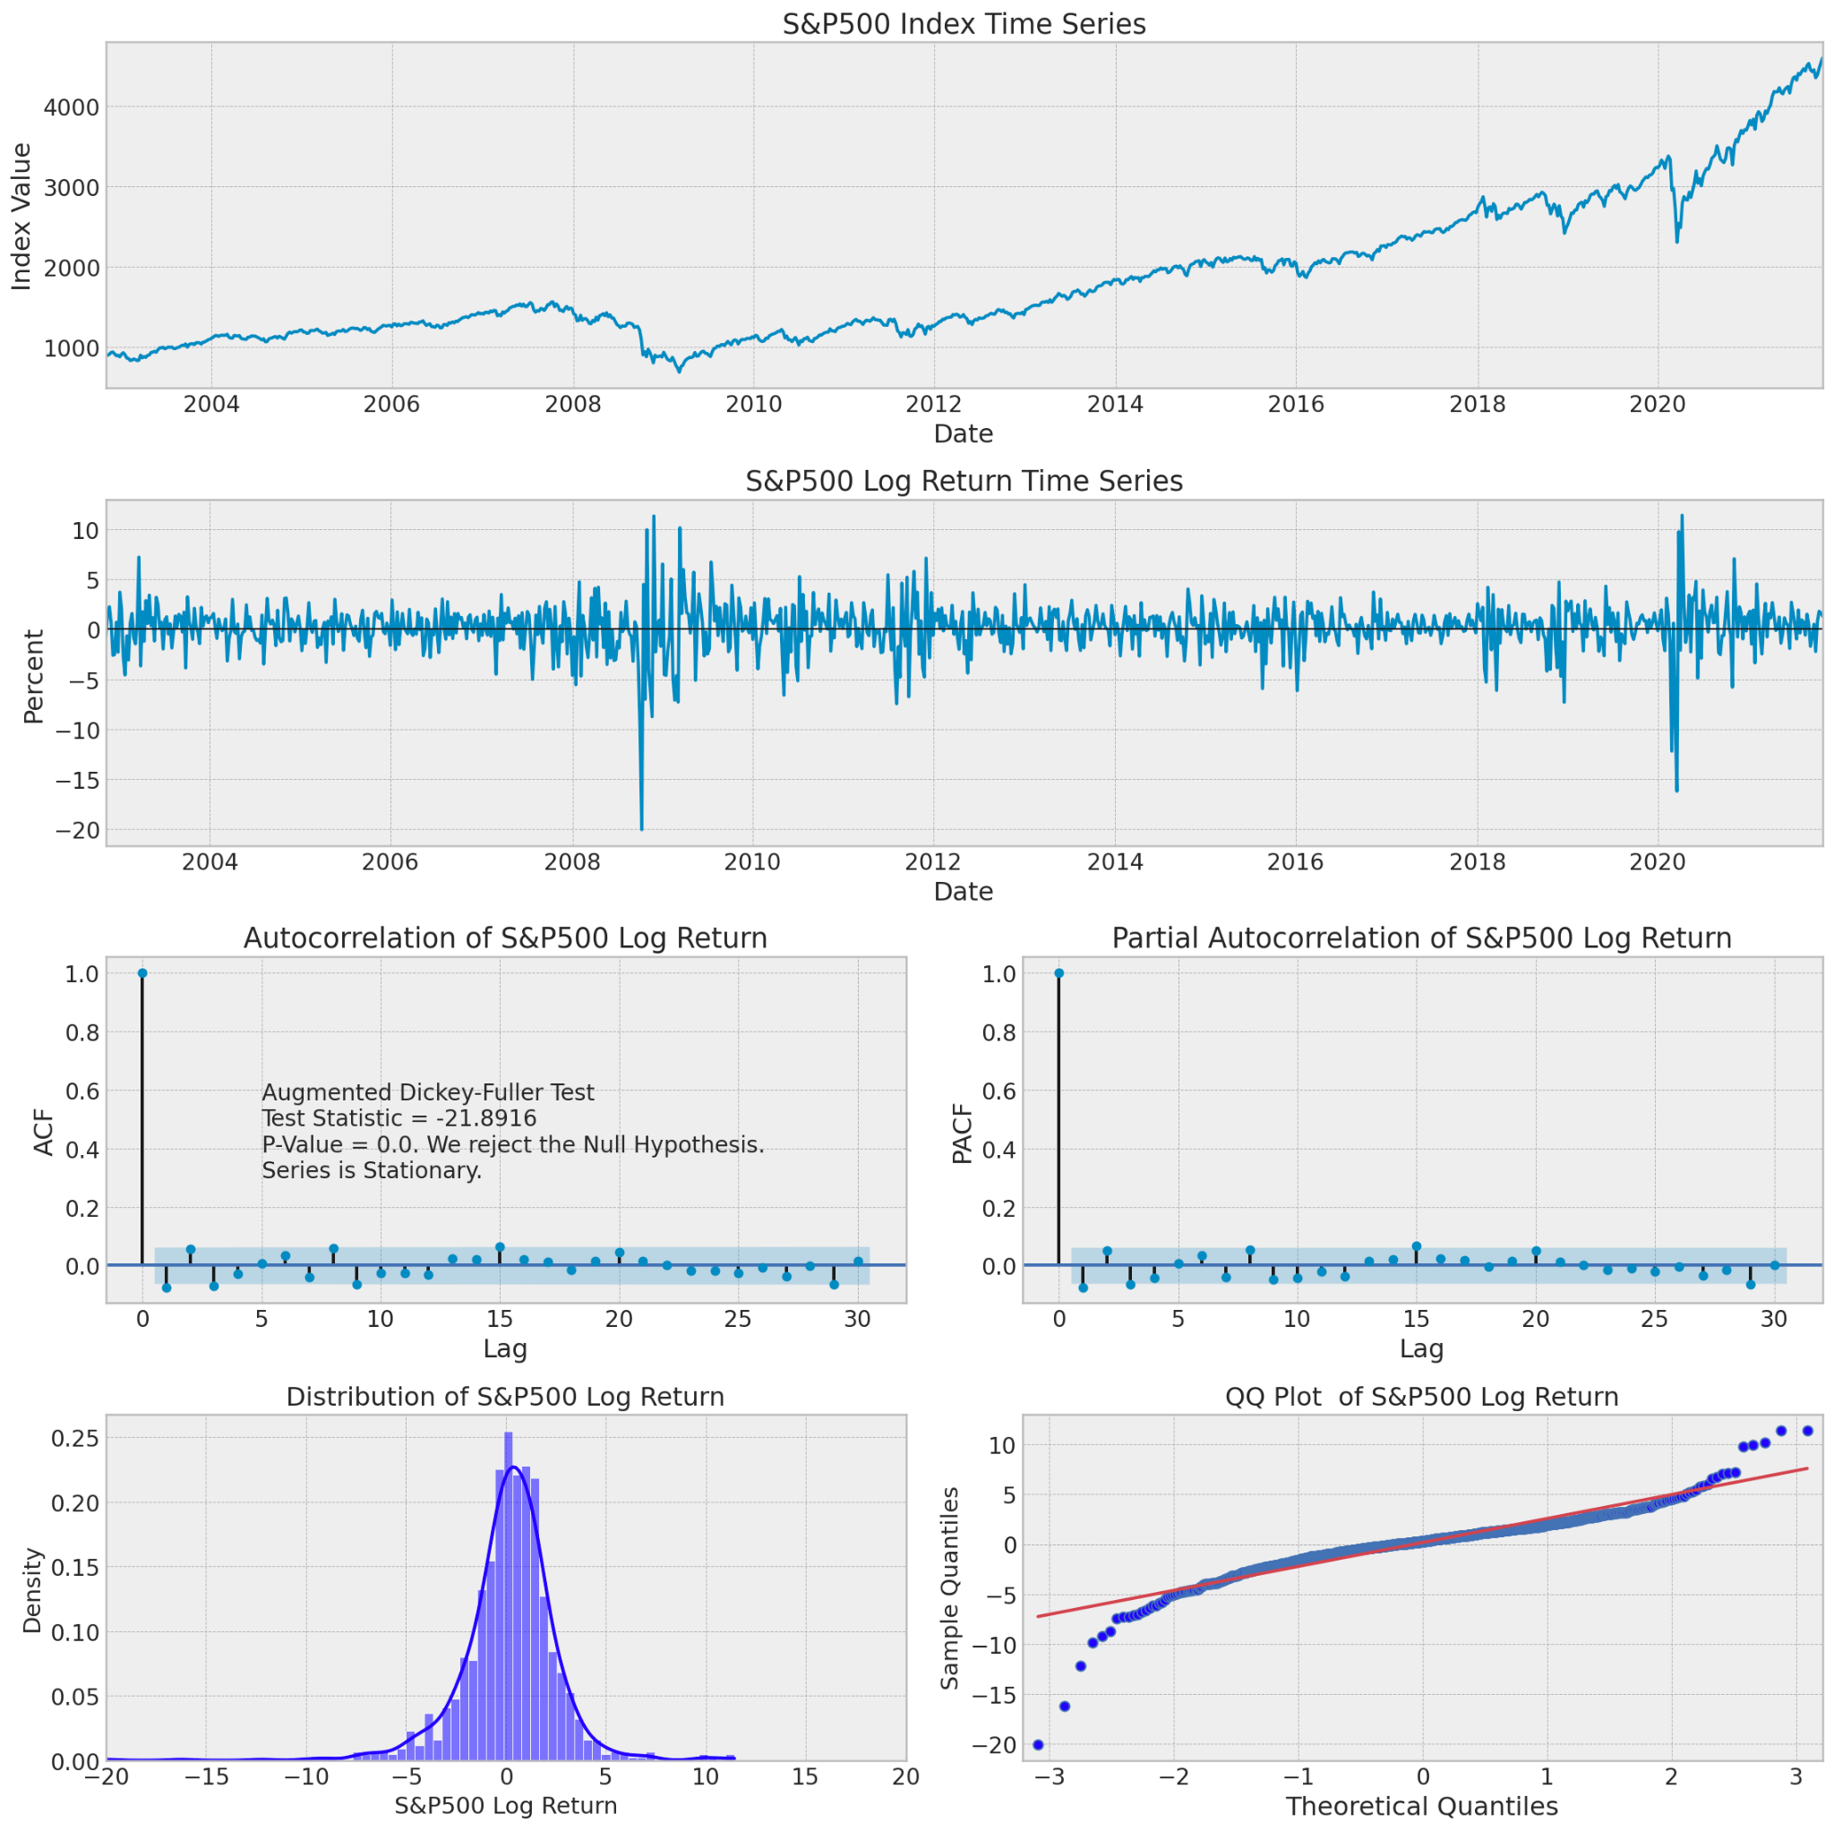
3.2 Stationarity
ACF & PACF
Augmented Dickey-Fuller (ADF) test
Notes:
the log return of S&P 500 index price appears stationary across the years
no extreme spikes in the ACF and PACF plots, there appears to be no autocorrelation in the time series, showing evidence that the data is stationary. To confirm stationarity, the Augmented Dickey-Fuller (ADF) test is applied to the data.
Q-Q plot -> normally distributed

Slide 10
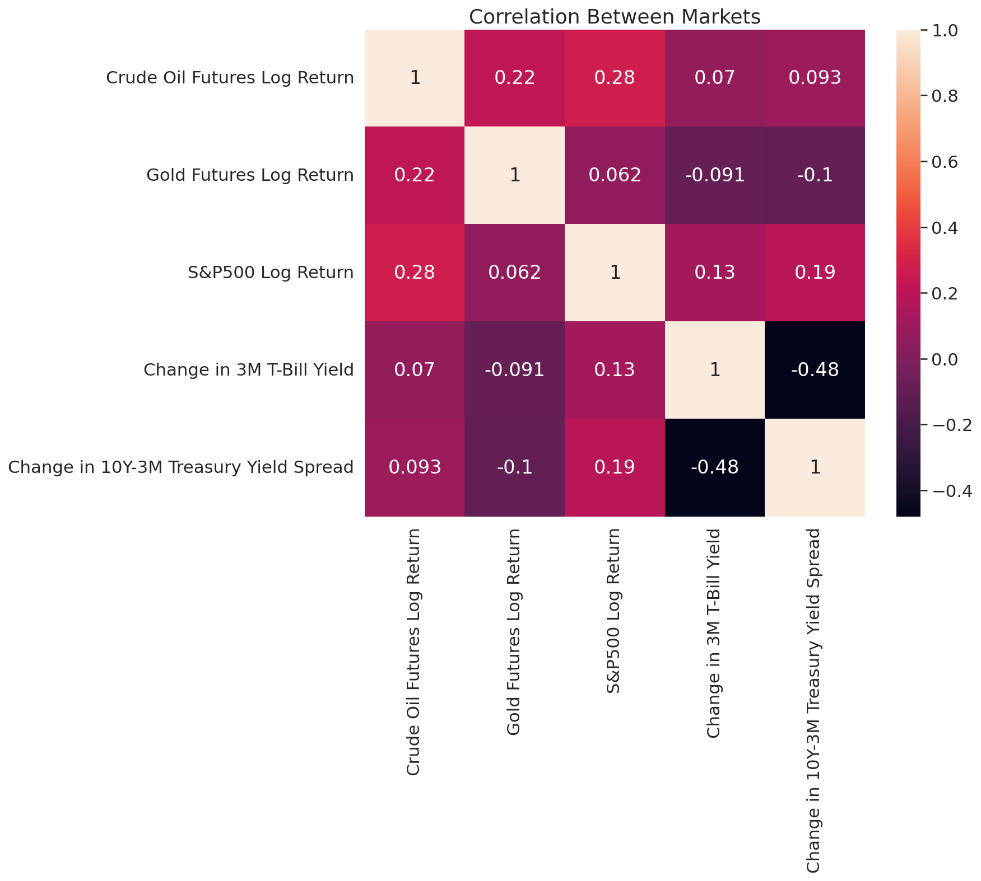
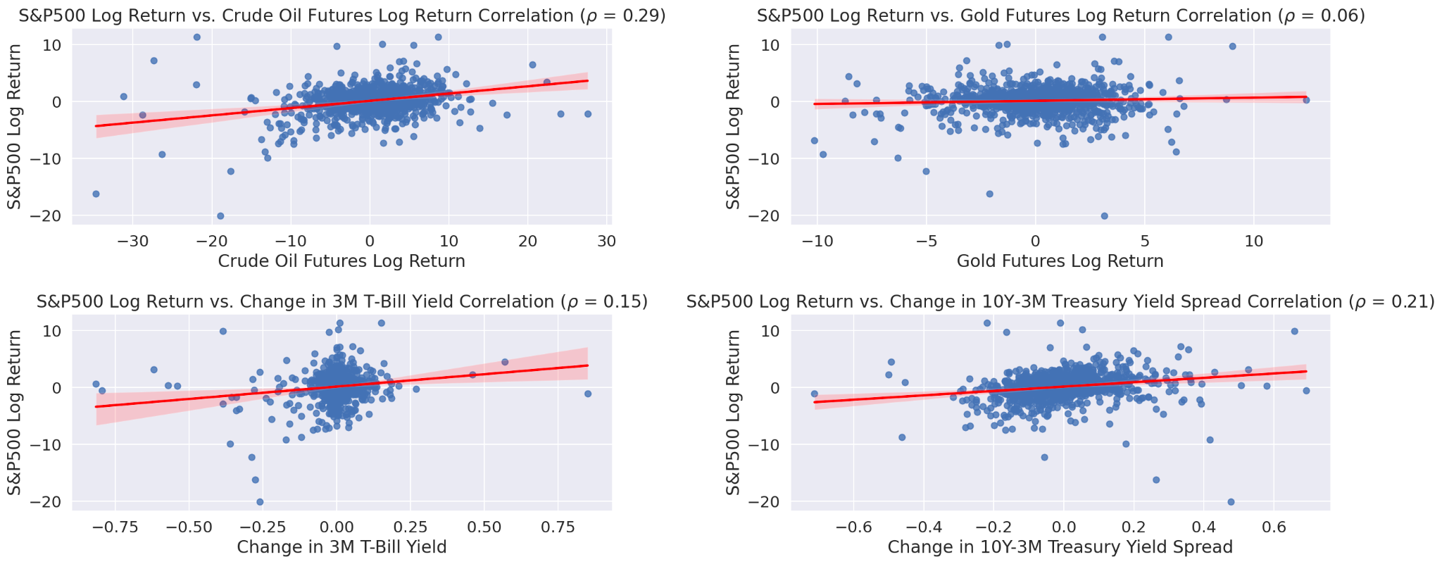
3.3 Correlation
0.29 correlation between crude oil and S&P 500

Slide 11
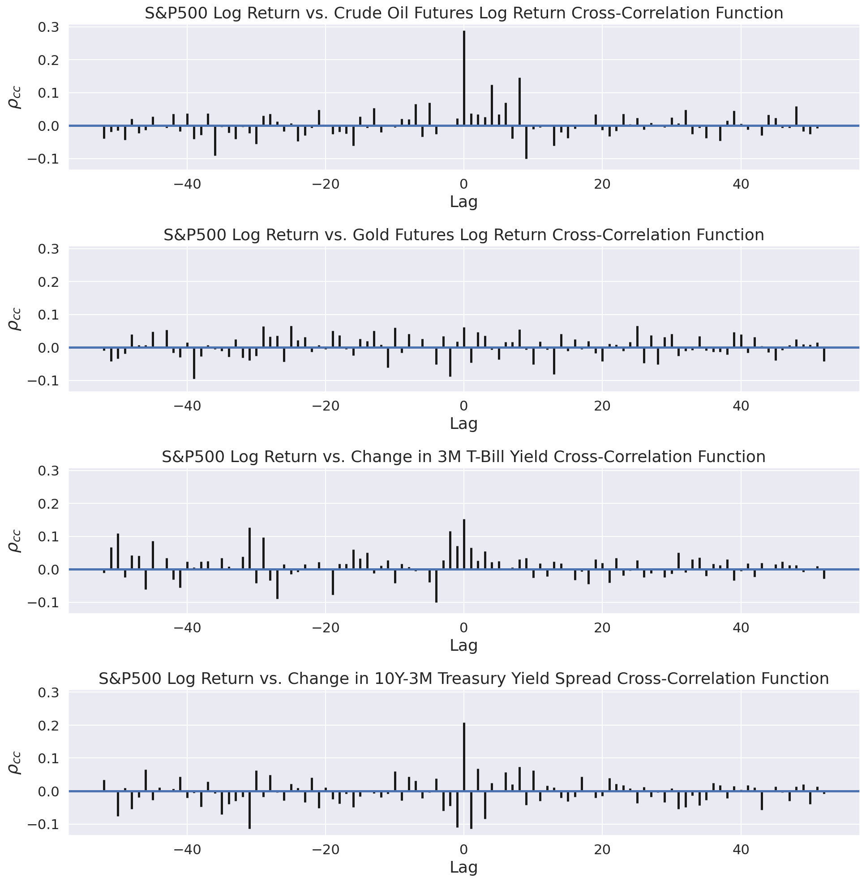
3.3.2 Cross-correlation

Slide 12
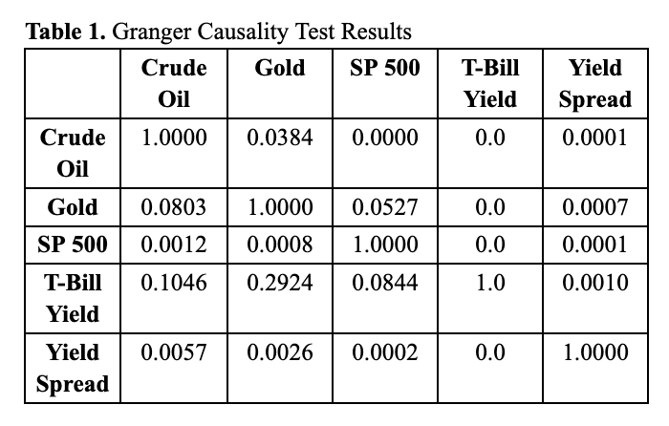
3.3.3 Granger-causality Test
gold Granger-causes S&P 500 with a p-value of 0.0384, while S&P 500 does not Granger-cause gold
we suspect gold is useful to predict S&P 500
Analogously, T-bill yield seems promising
a good sign for lead-lag relationship

Slide 13
04
Models

Slide 14
Prediction Models
01
02
03
04
05
Historical Mean Model
Naive Model
Autoregression Model
Vector Autoregression Model
Long Short Term Memory (LSTM)

Slide 15
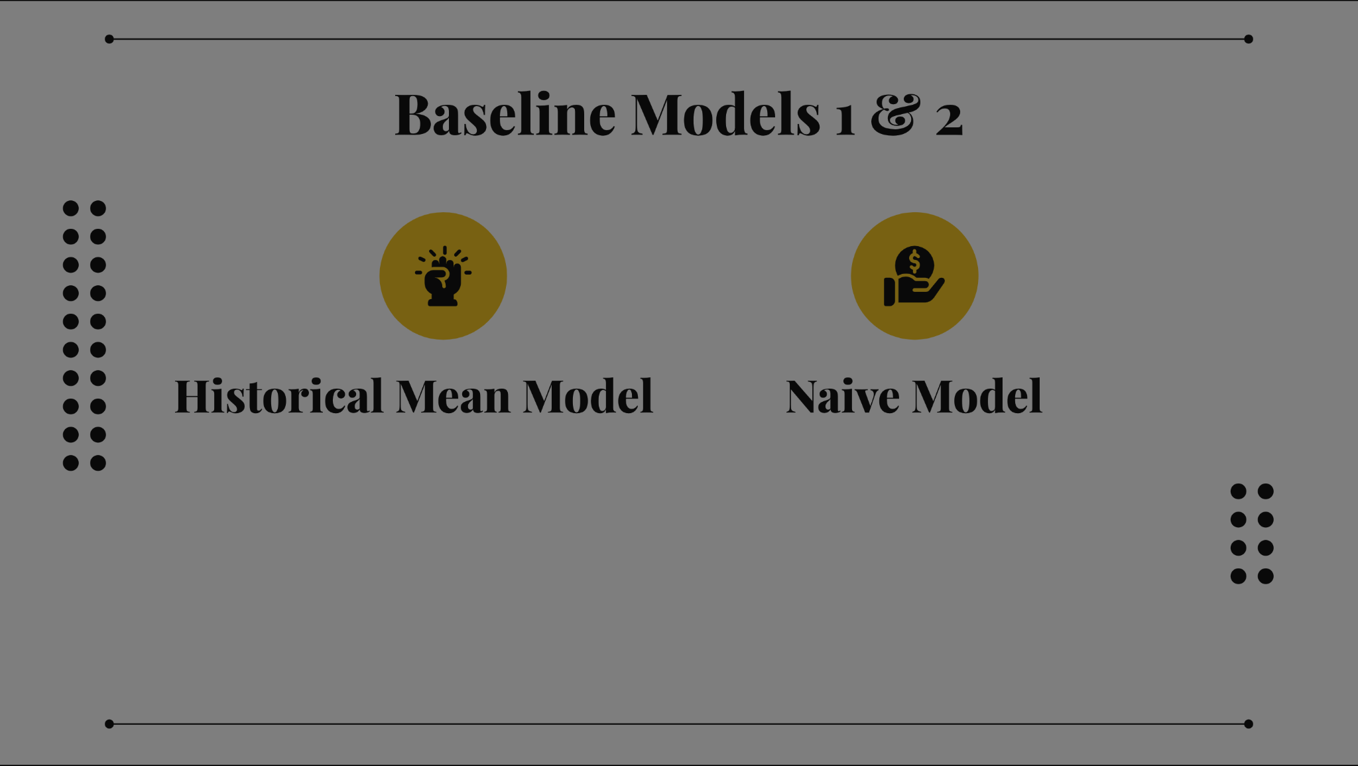

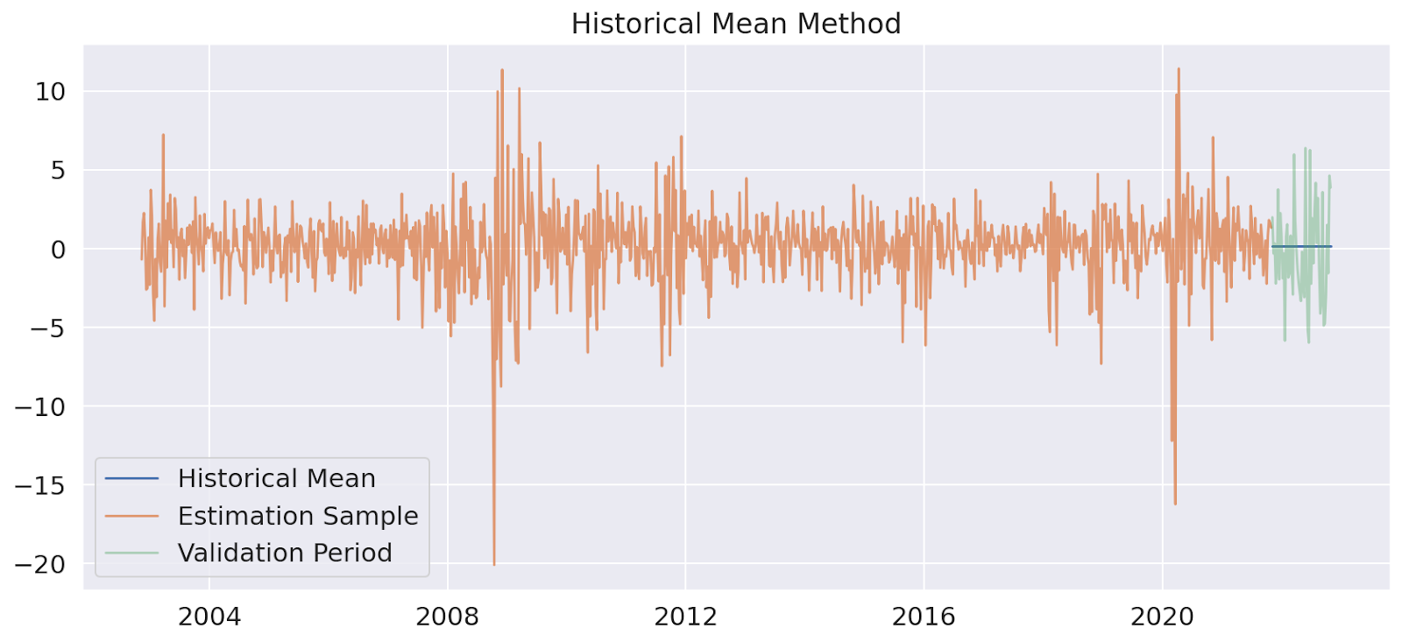
Baseline Model 1: Historical Mean Model
Notes:
In the historical mean model, future values are predicted as the average of training data.

Slide 16
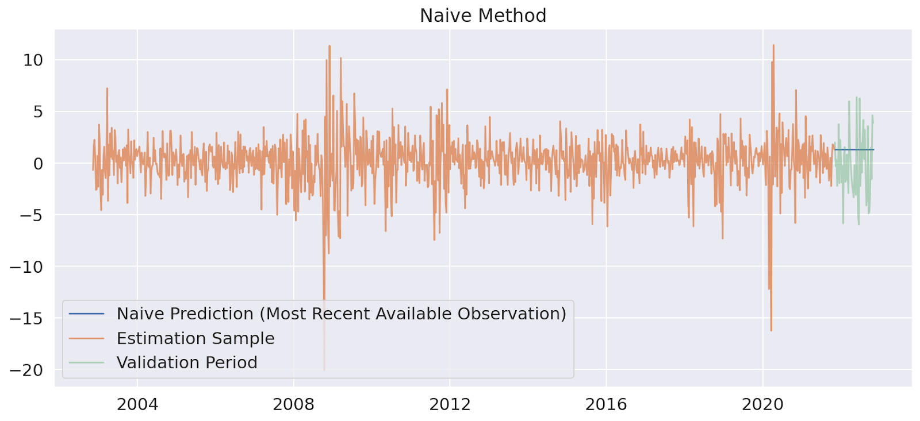
Baseline Model 2: Naive Model
Notes:
For the naive method, all forecasts are set to be the value of last observation.

Slide 17
Baseline 3: Autoregressive Model
01
02
03
Akaike Information Criterion
In-sample Static Prediction
3-step
Ahead Forecasts
AR(p)
p=4
Notes:
In order to construct an AR model, we first decide the order of the model using AIC, with a penalty term for model complexity.
Based on the result of AIC, we set p = 4

Slide 18
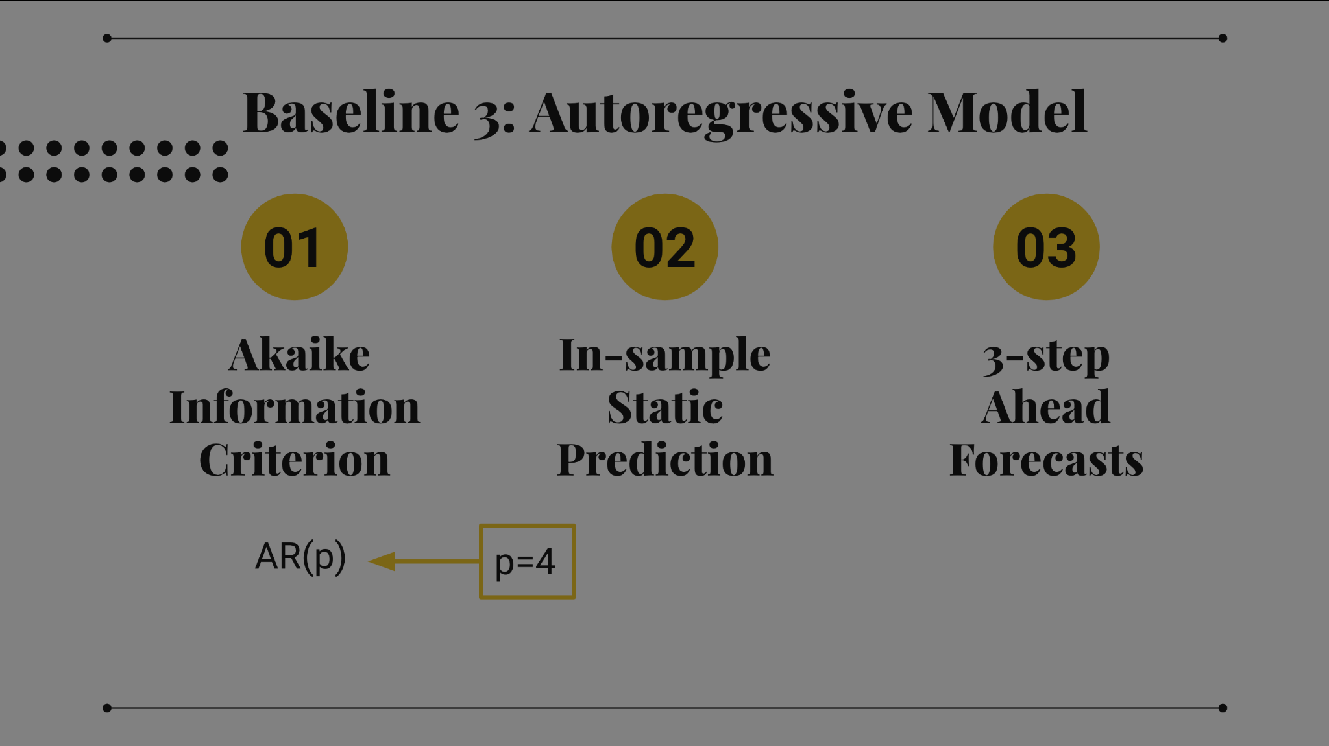

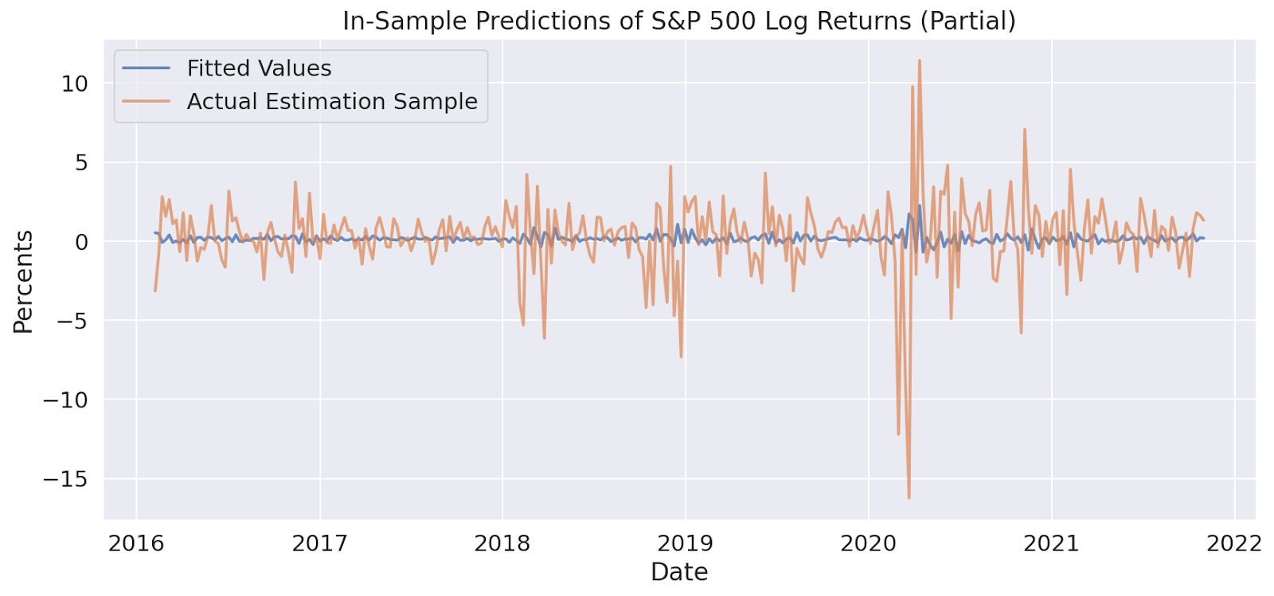
Notes:
To evaluate the model, we first generate the in-sample static predictions to see how well our model performs in the training data.

Slide 19
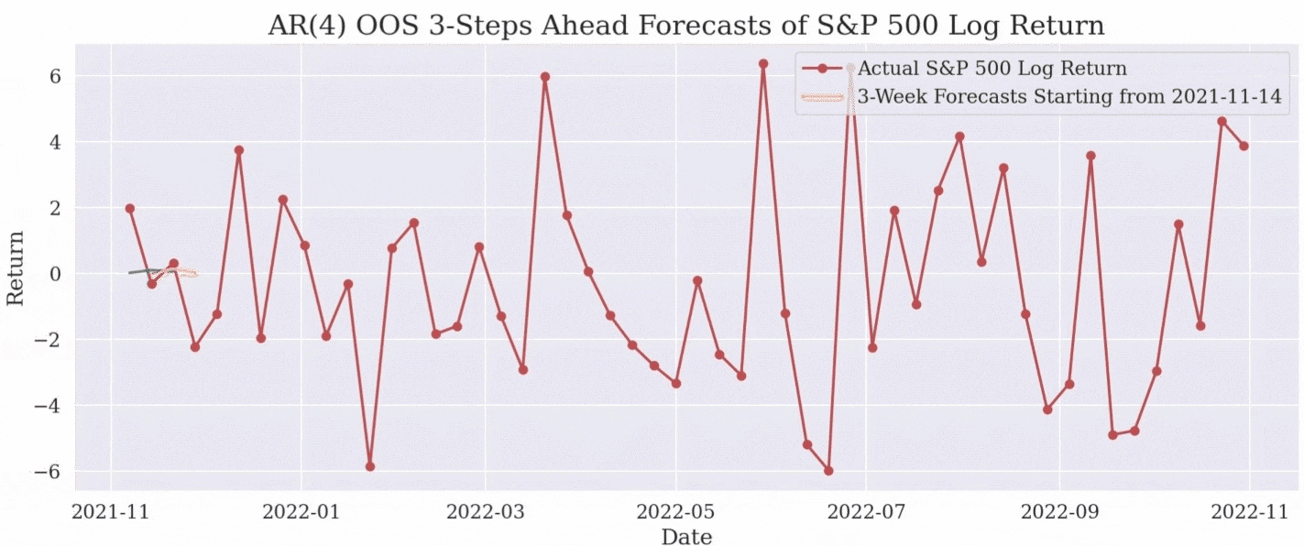
Notes:
we also generate 3-step ahead forecasts on the prediction set as we aim to forecast three weekly stock returns

Slide 20
Vector Autoregression Model
AR(p)
p=10
Notes:
The VAR model is a generalisation of the AR model, which specifies the bidirectional relationships between time series.
In this case, we select p=10.

Slide 21
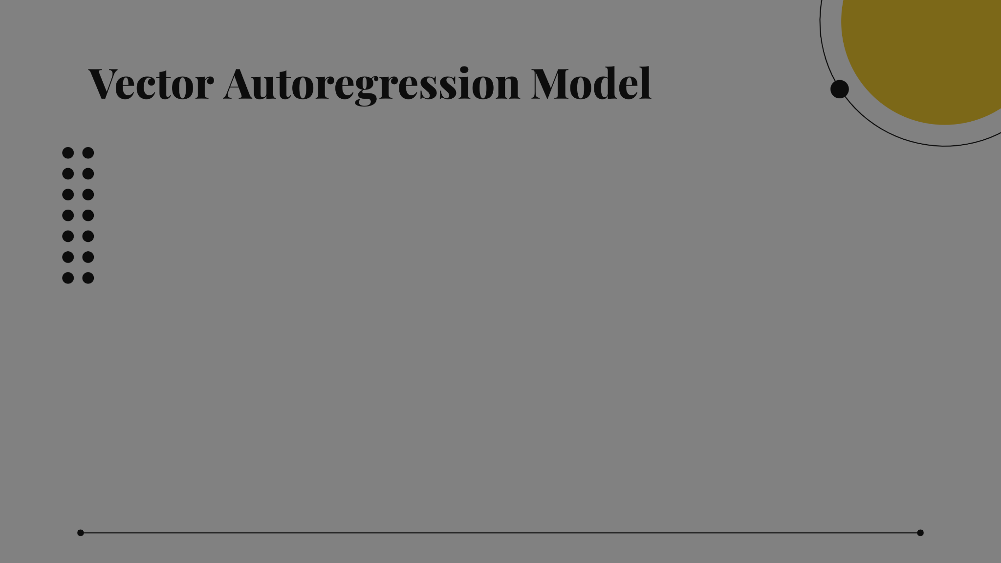
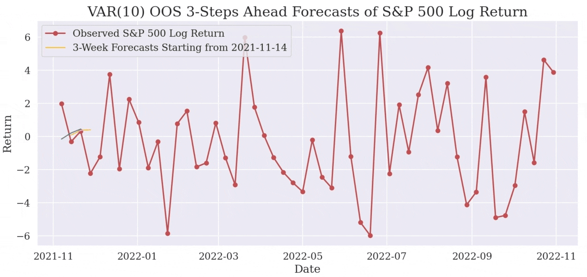
Notes:
Here is the forecast of our VAR model.

Slide 22
Durbin-Watson Test Result Table
 | Crude Oil | Gold | S&P 500 | T-Bill Yield | Yield Spread
Outcome | 1.9987 | 2.0008 | 1.9881 | 1.9899 | 1.9986
Notes:
Furthermore, we check the autocorrelation of residuals using the DW test.
Since we use percentage change and log returns rather than historical prices, we expect a weak autocorrelation
Here, all five predictors are close to 2, indicating that they have a low degree of autocorrelation

Slide 23
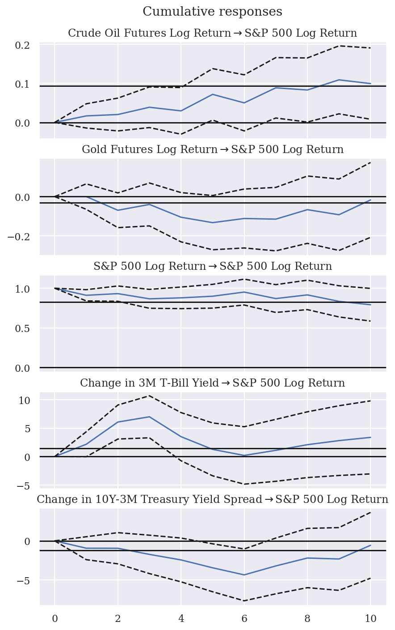
Impulse Response Function (IRF)
A function that lets us describe the evolution of S&P 500 in reaction to a shock in other variables
Cumulative IRF
S&P 500 largely moves up after a unit increase in T-Bill yield.
Result is significant.
Notes:
There are various ways to approach this problem: average method, naive method, and Autoregressive (AR) models.
.

Slide 24
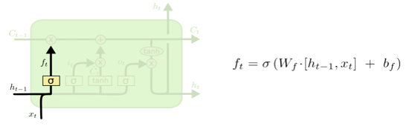
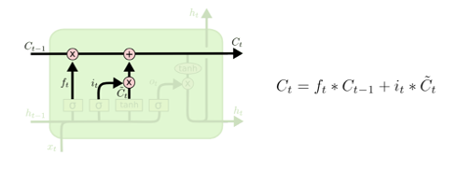
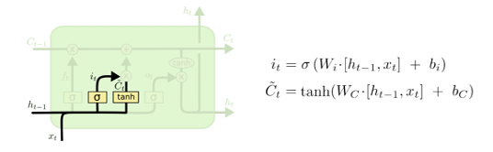
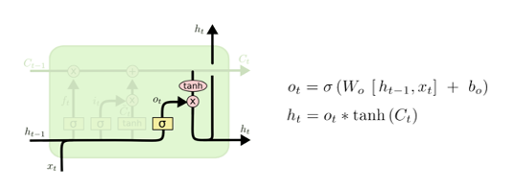
Long Short Term Memory (LSTM)
1) Forget Gate
Keeps or forgets info from previous step
3) Cell State
Gets updated with new info
2) Input Gate
Determines importance of new info
4) Output Gate
Decides which parts of cell state to output

Slide 25
LSTM Model Architecture
Output
Dense Layer
Dropout Layer
C_{t-2}¹
h_{t-1}¹
C_{t-1}¹
h_{t}¹
C_{t}¹
h_{t+1}¹
C_{t+1}¹
…
LSTM Cell
LSTM Cell
LSTM Cell
…
h_{t-2}¹
h_{t-1}¹
h_{t}¹
h_{t+1}¹
x_{t-2}
x_{t-1}
x_{t}
x_{t+1}
x_{t+2}

Slide 26
LSTM Model Selection
01
02
Cross Validation
Grid Search
Hyperparam | Values
Layer 1 nodes | [16,32,64,128]
Layer 2 nodes | [0,16,32,64,128]
Dropout rate | [0.1,0.2,0.3]
Batch size | [16,32,64]
Learning rate | [0.01,0.001,0.0001]
Expanding window cross validation
Number of splits: 3
Best Model Selected: 1 layer with 64 nodes, dropout rate=0.2, learning rate=0.001, batch size=32, recurrent activation function=ReLU, epoch=25

Slide 27
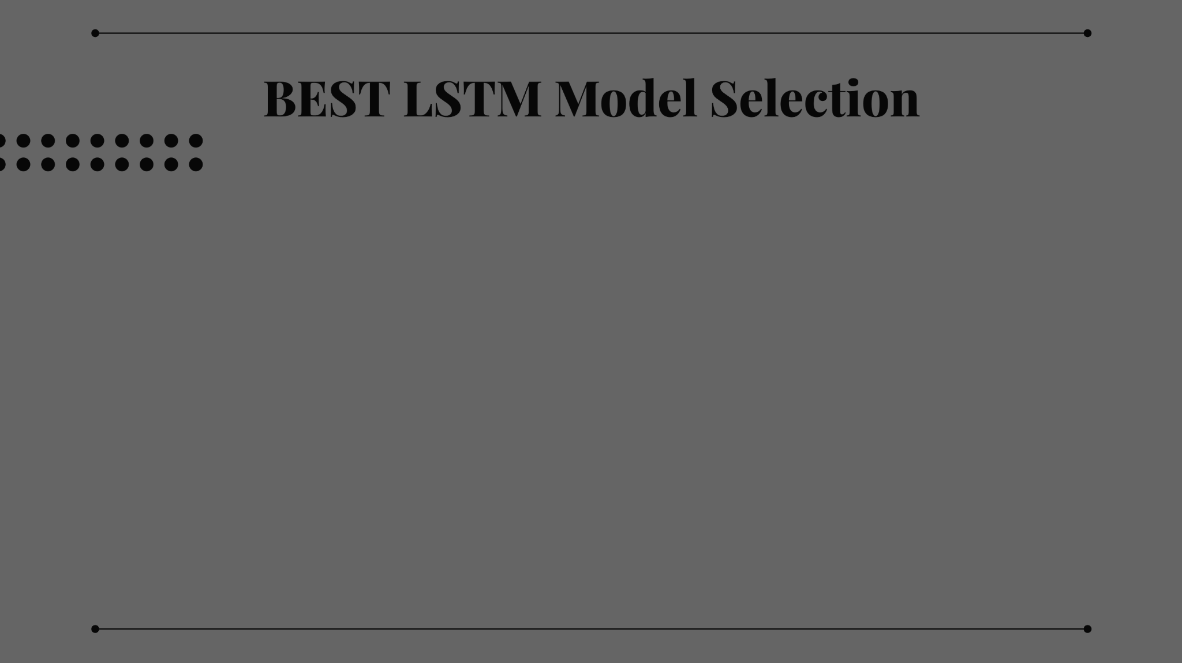
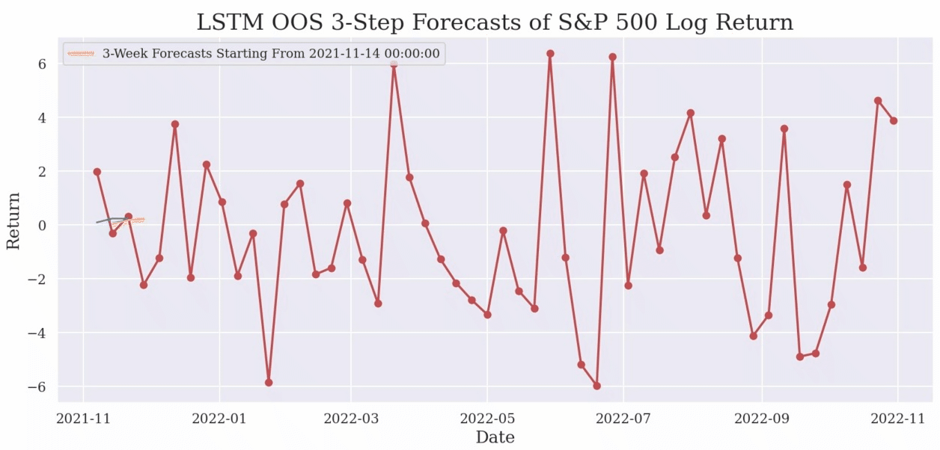

Slide 28
05
Results and Discussion

Slide 29
Models Comparison - Visual Inspection
1) Historical Mean Model
2) Naive Model
3) AR(4) Model
4) VAR(10) Model
5) Best LSTM Model

Slide 30
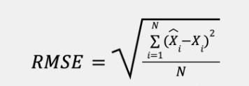
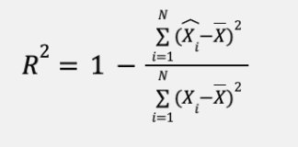
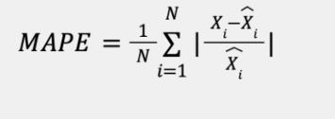
Models Comparison - Quantitative Metrics
01
02
03
Root Mean Squared Error (RMSE)
Mean Absolute Percentage Error (MAPE)
R-Squared (R2)
Notes:
In order to construct an AR model, we first decide the order of the model using AIC, with a penalty term for model complexity.
Based on the result of AIC, we set p = 4

Slide 31
Models Comparison - Quantitative Metrics
RMSE, MAPE, and R-Squared Values Comparison
 | Model | 1-Step Ahead | 2-Step Ahead | 3-Step Ahead
RMSE | Historical Mean | 3.0770 | 3.0770 | 3.0770
 | Naive | 3.4873 | 3.4873 | 3.4873
 | AR(4) | 3.0881 | 3.1324 | 3.1676
 | VAR(10) | 3.2412 | 3.2782 | 3.3015
 | LSTM | 2.9108 | 3.0824 | 3.1285
MAPE | Historical Mean | 1.0689 | 1.0689 | 1.0689
 | Naive | 1.8922 | 1.8922 | 1.8922
 | AR(4) | 1.1201 | 1.1422 | 1.0768
 | VAR(10) | 1.3203 | 1.4188 | 1.2769
 | LSTM | 1.0607 | 1.2046 | 1.2122
R2 | Historical Mean | 0.0 | 0.0 | 0.0
 | Naive | -0.2845 | -0.2845 | -0.2845
 | AR(4) | -0.0629 | -0.0470 | -0.0303
 | VAR(10) | -0.17095 | -0.1467 | -0.1193
 | LSTM | 0.05565 | -0.005021 | -0.005021
One-Step Ahead
Best Model: LSTM
Lowest RMSE and MAPE values
Positive R2 value
Runner-up: Historical Mean

Slide 32
Models Comparison - Quantitative Metrics
RMSE, MAPE, and R-Squared Values Comparison
 | Model | 1-Step Ahead | 2-Step Ahead | 3-Step Ahead
RMSE | Historical Mean | 3.0770 | 3.0770 | 3.0770
 | Naive | 3.4873 | 3.4873 | 3.4873
 | AR(4) | 3.0881 | 3.1324 | 3.1676
 | VAR(10) | 3.2412 | 3.2782 | 3.3015
 | LSTM | 2.9108 | 3.0824 | 3.1285
MAPE | Historical Mean | 1.0689 | 1.0689 | 1.0689
 | Naive | 1.8922 | 1.8922 | 1.8922
 | AR(4) | 1.1201 | 1.1422 | 1.0768
 | VAR(10) | 1.3203 | 1.4188 | 1.2769
 | LSTM | 1.0607 | 1.2046 | 1.2122
R2 | Historical Mean | 0.0 | 0.0 | 0.0
 | Naive | -0.2845 | -0.2845 | -0.2845
 | AR(4) | -0.0629 | -0.0470 | -0.0303
 | VAR(10) | -0.17095 | -0.1467 | -0.1193
 | LSTM | 0.05565 | -0.005021 | -0.005021
One-Step Ahead
Best Model: LSTM
Lowest RMSE and MAPE values
Positive R2 value
Runner-up: Historical Mean
Two-Step and Three-Step Ahead
Best Model: Historical Mean
Lowest RMSE and MAPE values
R2 value equal to zero
Runner-up: LSTM
Note: RMSE, MAPE, and R2 values are only slightly worse than historical mean model

Slide 33
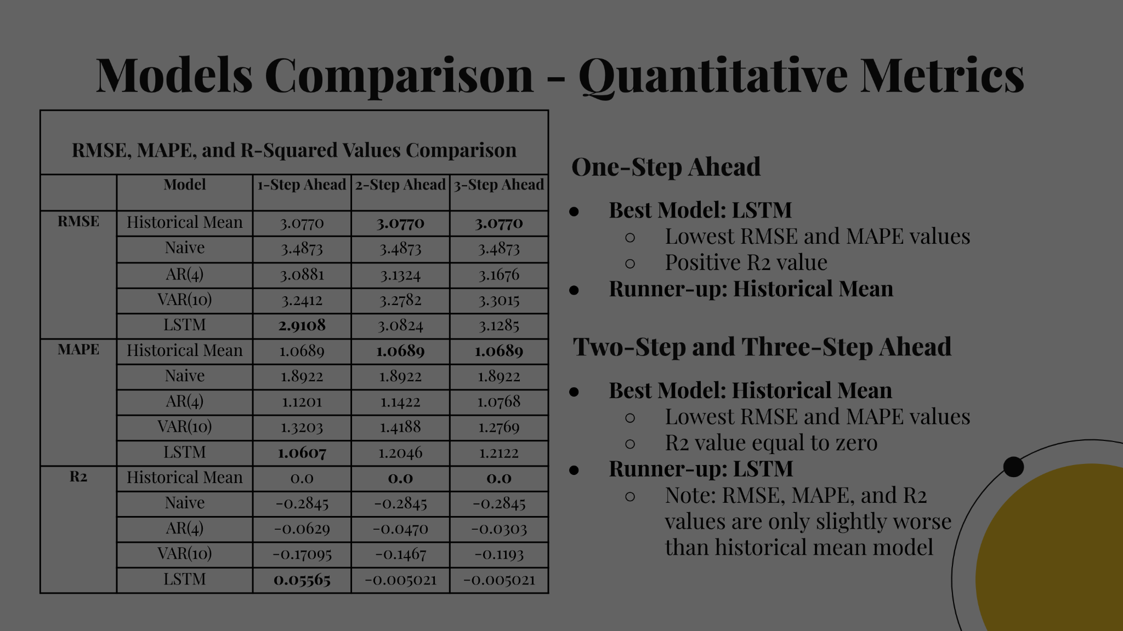
Models Comparison - Quantitative Metrics
RMSE, MAPE, and R-Squared Values Comparison
 | Model | 1-Step Ahead | 2-Step Ahead | 3-Step Ahead
RMSE | Historical Mean | 3.0770 | 3.0770 | 3.0770
 | Naive | 3.4873 | 3.4873 | 3.4873
 | AR(4) | 3.0881 | 3.1324 | 3.1676
 | VAR(10) | 3.2412 | 3.2782 | 3.3015
 | LSTM | 2.9108 | 3.0824 | 3.1285
MAPE | Historical Mean | 1.0689 | 1.0689 | 1.0689
 | Naive | 1.8922 | 1.8922 | 1.8922
 | AR(4) | 1.1201 | 1.1422 | 1.0768
 | VAR(10) | 1.3203 | 1.4188 | 1.2769
 | LSTM | 1.0607 | 1.2046 | 1.2122
R2 | Historical Mean | 0.0 | 0.0 | 0.0
 | Naive | -0.2845 | -0.2845 | -0.2845
 | AR(4) | -0.0629 | -0.0470 | -0.0303
 | VAR(10) | -0.17095 | -0.1467 | -0.1193
 | LSTM | 0.05565 | -0.005021 | -0.005021
One-Step Ahead
Best Model: LSTM
Lowest RMSE and MAPE values
Positive R2 value
Runner-up: Historical Mean
LSTM is the best overall model
Two-Step and Three-Step Ahead
Best Model: Historical Mean
Lowest RMSE and MAPE values
R2 value equal to zero
Runner-up: LSTM
Note: RMSE, MAPE, and R2 values are only slightly worse than historical mean model

Slide 34
06
Future Work

Slide 35
Future Work
01
Conversion Back to Original Time Series
A Comprehensive Forecasting Model with Trend, Seasonal, and Cyclic components
02
03
Other Nonlinear Models
More rigorous residual diagnostics, stability assessment, and model selection
04
Notes:
More rigorous residual diagnostics, stability assessment, and model selection

Slide 36

Acknowledgement
We like to express our appreciation to
Prof. Pavlos, Chris, and all TFs
for all of the guidance and support!

Slide 37

Thanks!
Present by Team 12

